Slide 1
EDA – S&P 500 index predicted by Reddit Posts and commodity prices
B y : T h o m a s

Slide 2
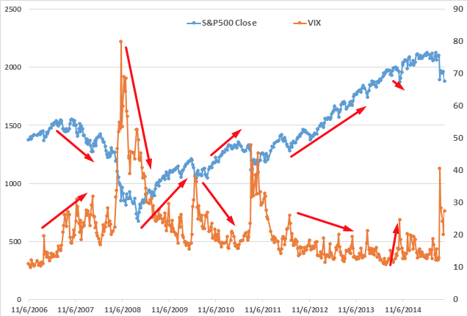
Cliché?
Perhaps…
It’s been done by:
Students
Researchers
Kaggle
But, I’m going to do it better!

Slide 3

Data Sources
There is a lot free stuff out there
Can get gold prices, oil prices, and stock prices very easily
Can get a TON of data off of Reddit and the Fed website
Titles, comments, articles, post score, dates

Slide 4
Methodology
Use data of day ‘x’ to predict S&P prices of day ‘x+t’
The correct ‘t’ (days) is TBD
Commodities:
Use moving average instead of day price to offset volatility
Reddit and Fed
Fed has economic articles
Reddit has many articles
Eliminate non-sequiturs
Gauge relevance of article and comments by keywords
Correlate Fed and Reddit Articles
Create importance value

Slide 5
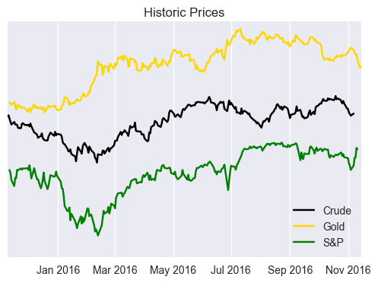
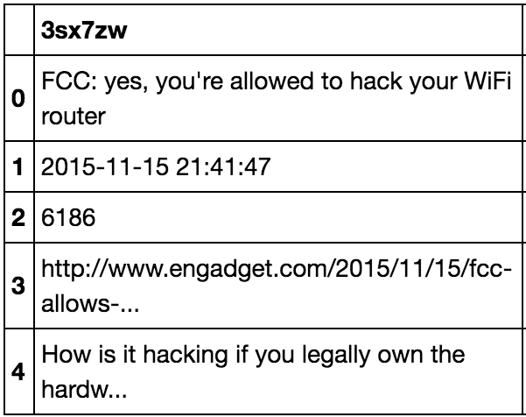
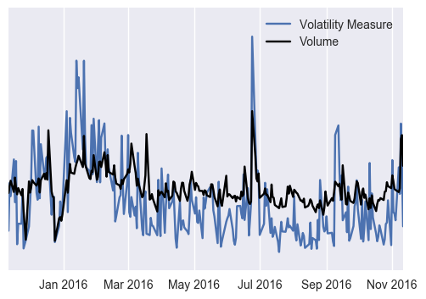
Current progress
Stock, commodity, and index prices are done
Reddit has been scraped and words have been vectorized
Keywords have been scraped and listed

Slide 6
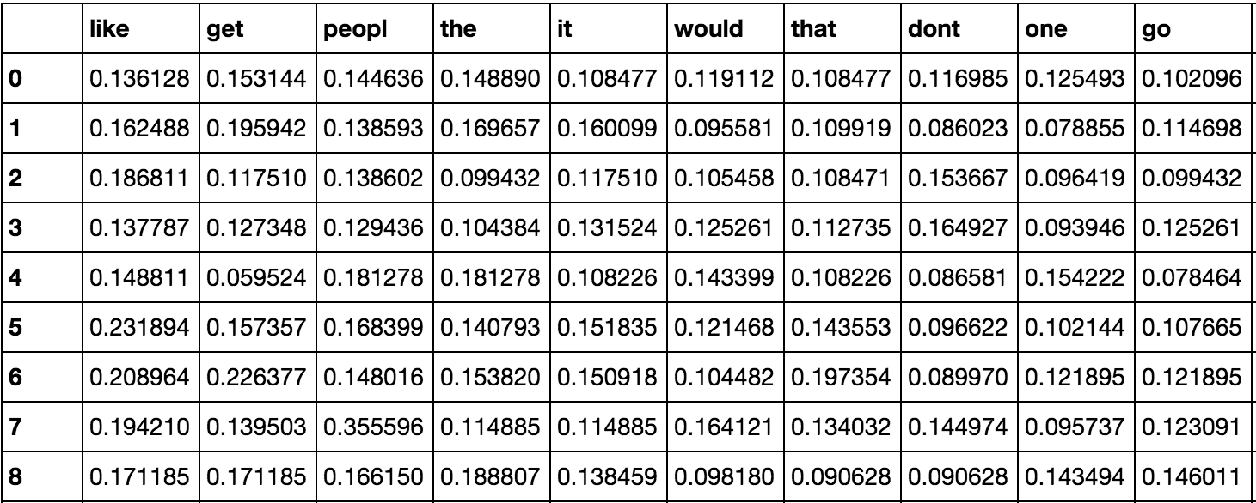
Questions?

